Slide 1
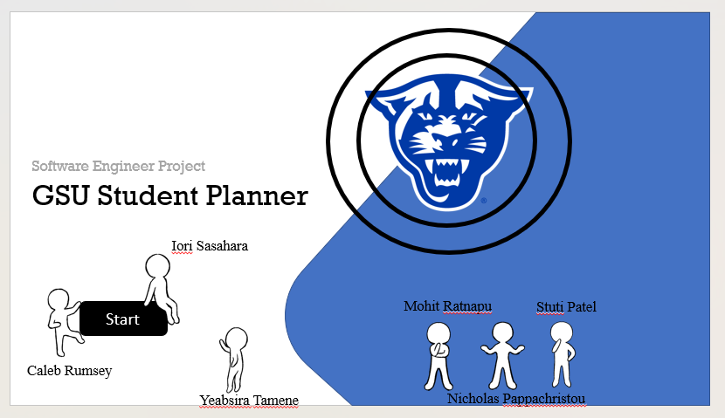

Slide 2
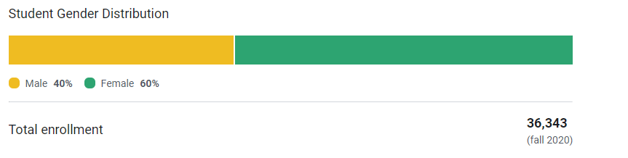
Introduction
In 2020, Georgia State University had over 36,343 students enrolled according to US News. The National Center for Education Statistics states that Forty percent of students who enroll in a four-year college don’t graduate within six years. We believe in the case of many students, dropping out or delayed graduation could have been easily prevented if students had a clearer idea of what they needed to accomplish to graduate.

Slide 3
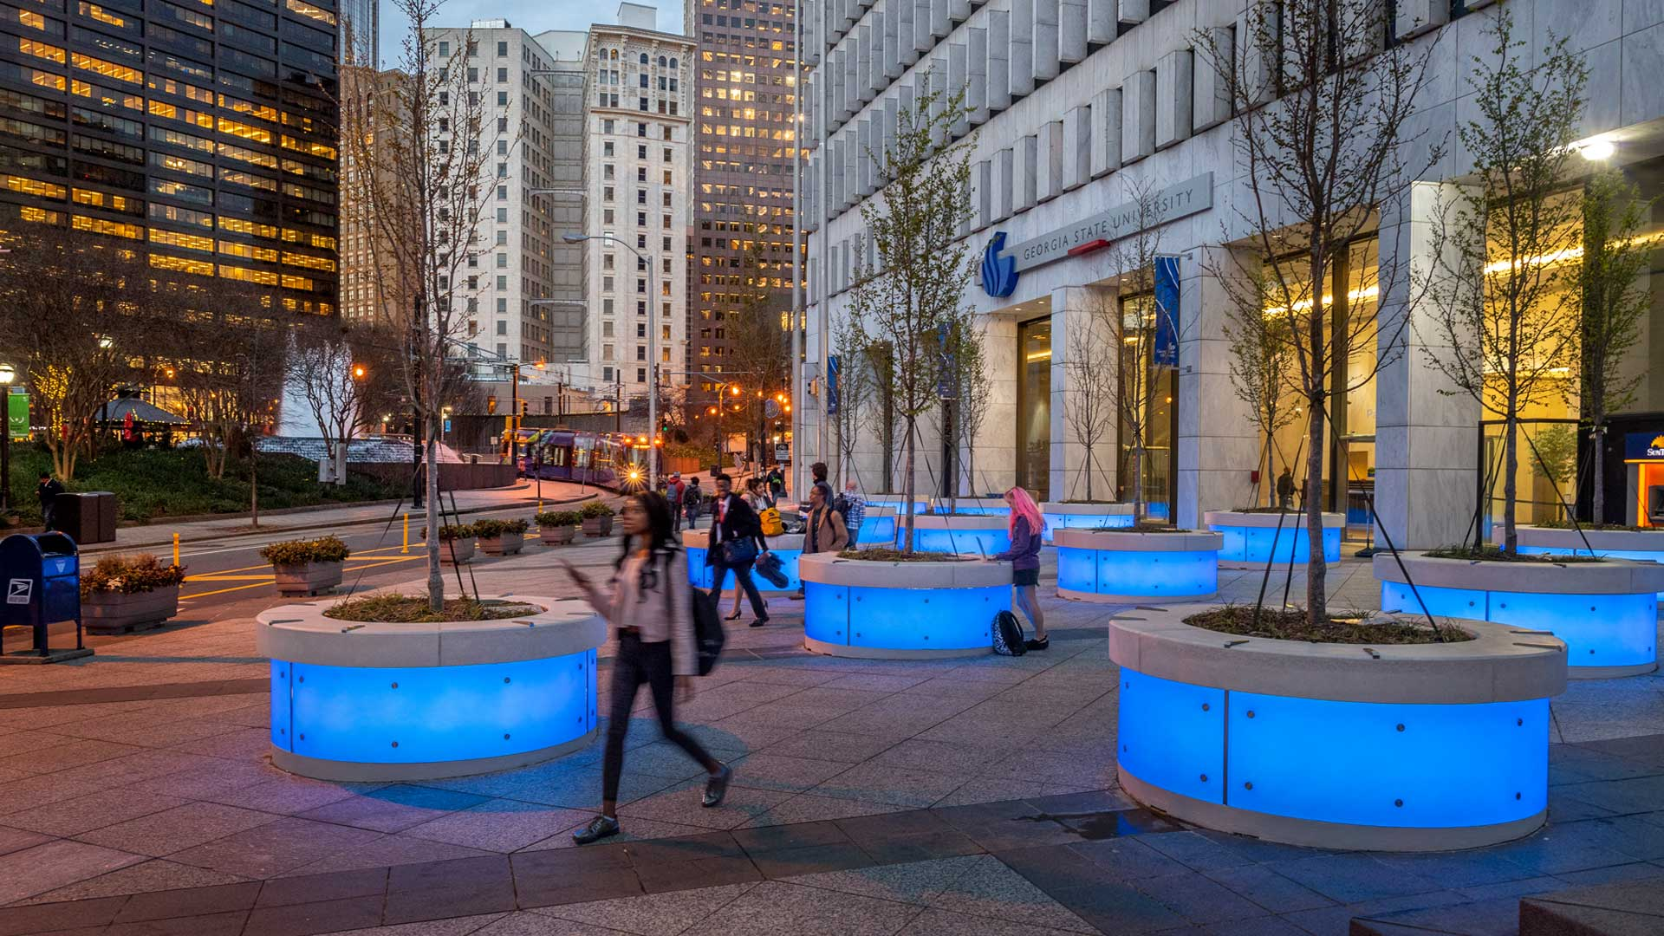

Introduction
Our idea is a simple but effective one for GSU students. While one might see a planner to have a small significance in one’s college career, we believe that having one tailored specifically to GSU would greatly decrease the percentage of students not graduating on time or at all. Our idea is to have a schedule website that can be accessible to any GSU student and can be tailored to their specific needs while at GSU. We plan to implement features such as a GPA calculator, a class navigator, a list of what classes you’ve taken and what you need as well as a four year plan of study for each degree (*might be taken out depending on how complicated this task is) and a plethora of other features.

Slide 4

Introduction
Of course, these features can easily be done with other apps, websites or can even be done by hand with a notebook and pen. However, by building this site we aim to simplify the process of using multiple tools to see if you’re on track for graduation. It can remove tedious steps of a student struggling to figure out all the information on their own which can potentially discourage a student or make them lose motivation.

Slide 5
Team Members
Stuti Nishantkumar Patel
Mohit K. Ratnapu
Iori K. Sasahara
Nicholas P. Pappachristou
Yeabsira H. Tamene
Caleb B. Rumsey

Slide 6
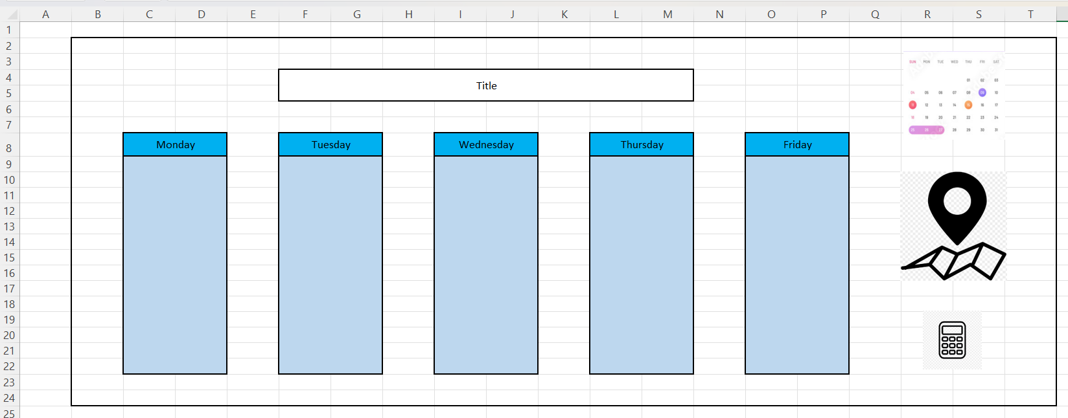
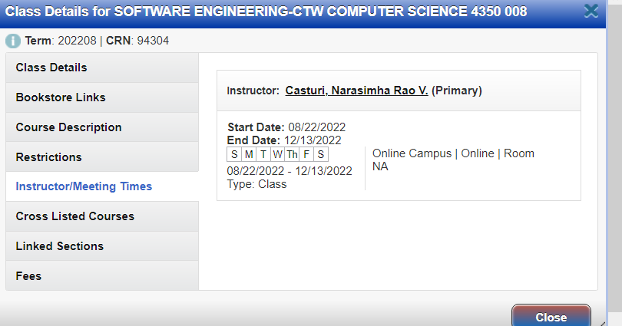
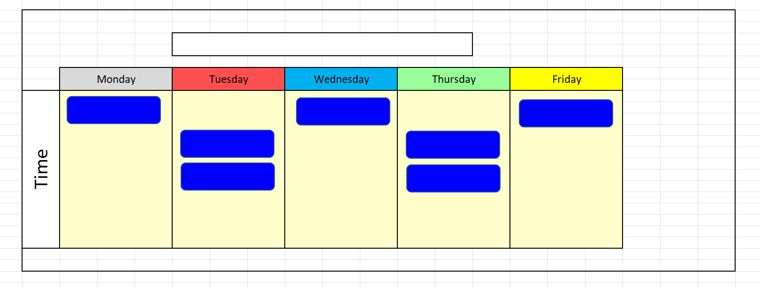
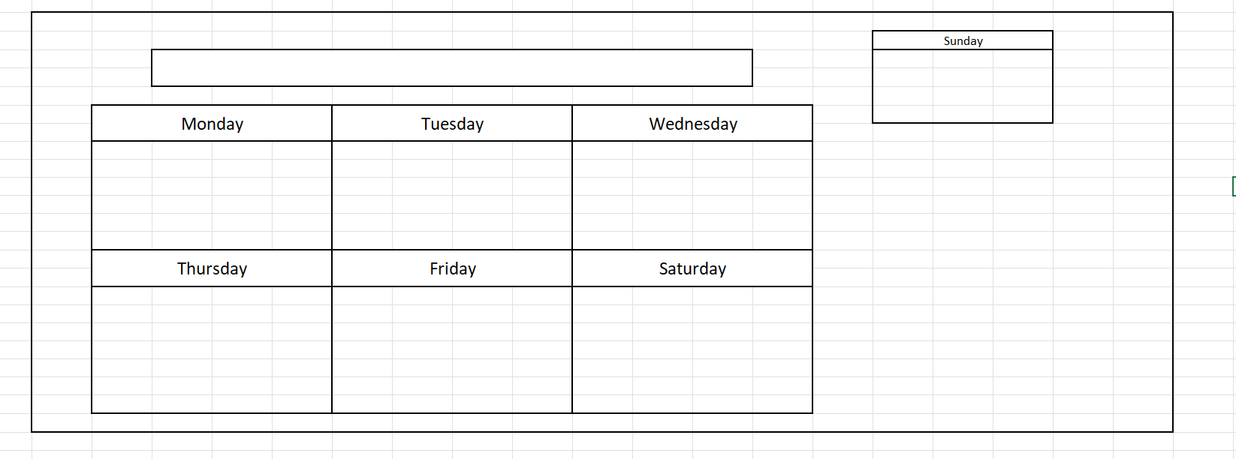
Visual Concepts (Proto)

Slide 7
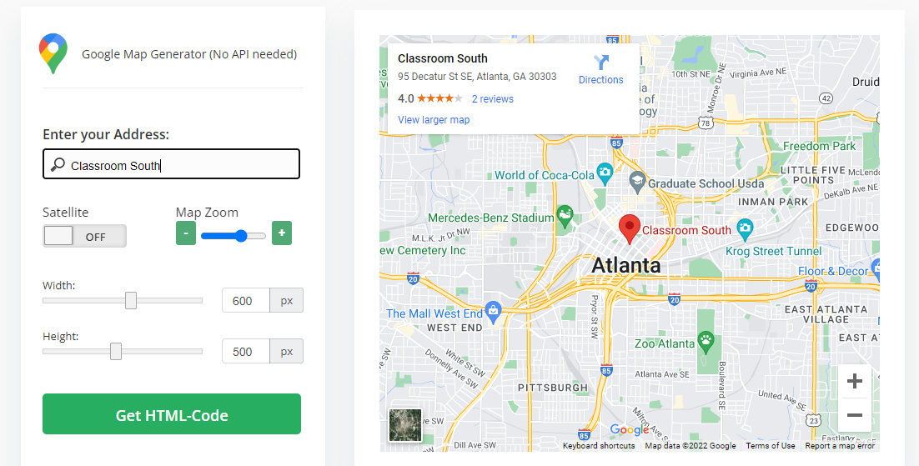
Google Map Navigation

Slide 8
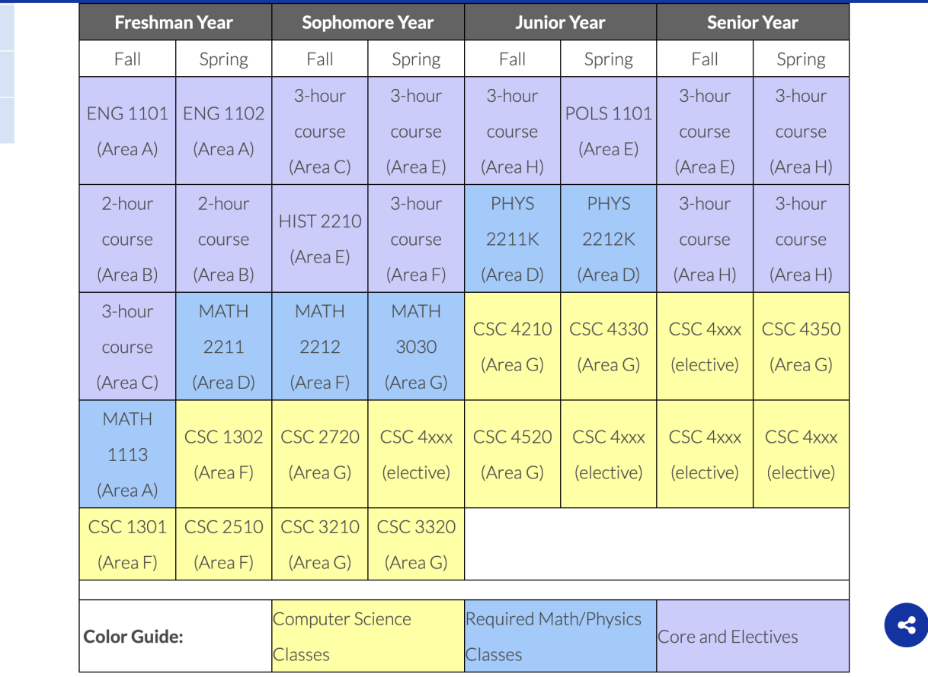
Four Year Plan

Slide 9


Technologies
At this time, some of the technologies are to be determined as of now while we’re still in our planning phase. What we do know is that we will certainly be needing to use HTML, CSS, and JavaScript for our site. Our plan as of now is to use WordPress as our host for our site. We are also considering how best to implement a database for the site. We are also in the process of figuring out how to best pull data from other sites such as PAWS.

Slide 10
Thank you for your time

